Slide 1
2. Event Handling
Chapter 22

Slide 2
Contents
The Delegation Event Model
Event Classes
Sources of Events
Event Listener Interfaces
Using the Delegation Event Model
Adapter Class
Inner Class

Slide 3
Introduction
Applets are event-driven programs that use a GUI to interact with the user
Any GUI application will be event driven
Supported in “java.awt.event” class
E.g.., Mouse click, Keyboard hit, button, scroll bar, or check box controls…

Slide 4
Introduction
2 ways to handle events
Traditional approach - By Java version 1.0
An event, after generated, was propagated up the containment hierarchy of listeners until it was handled by a component
The other component’s time is hence wasted
Modern Approach - Beginning with Java versions 1.1
listeners must register with a source in order to receive an event notification.
Hence notifications are sent only to listeners that want to receive them

Slide 5
1. The Delegation Event Model
Modern approach of event handling follows – Delegation event model
“A source generates an event and sends it to one or more listeners”
The listener simply waits until it receives an event
Once an event is received, the listener processes the event and then returns the response
Advantage: User Interface logic is separated from Application logic
User interface delegates the processing of event to another piece of code

Slide 6
1. The Delegation Event Model...
Application logic
User Interface logic
Application Interface
(Listeners)
User Interface
(Source)
Events
Response
Process the Event

Slide 7
Events
An event is an object that describes a state change in a source
Generated as a consequence of a person interacting with the elements in a graphical user interface
E.g.., Mouse clicks, user enters key, selecting a menu
Events may also occur that are not directly caused by interactions with a user interface
E.g.., when a timer expires, a counter exceeds a value

Slide 8
Event Sources
A source is an object that generates an event
This occurs when the internal state of that object changes in some way.
Sources may generate more than one type of event
A source must register listeners using a registration method:
public void addTypeListener(TypeListener el)
where Type – Name of the Listener
E.g.., addKeyListener( ), addMouseMotionListener( )
Removing listeners:
public void removeTypeListener(TypeListener el)

Slide 9
Event Listeners
A listener is an object that is notified when an event occurs
2 requirements:
It must have been registered with one or more sources to receive notifications
it must implement methods to receive and process these notifications
The methods are found in java.awt.event

Slide 10
2. Event Classes
The root of the Java event class hierarchy is EventObject, which is in java.util
Constructor EventObject(Object src)
src is the object that generates this event
It has 2 methods:
getSource( ) → returns the source of the event
toString( ) → returns the string equivalent of the event

Slide 11
AWTEvent Class
The AWTEvent, defined within the java.awt package, is a subclass of EventObject
It is the superclass of all AWT-based events used by the delegation event model.
Method: int getID( )
used to determine the type of the event

Slide 12
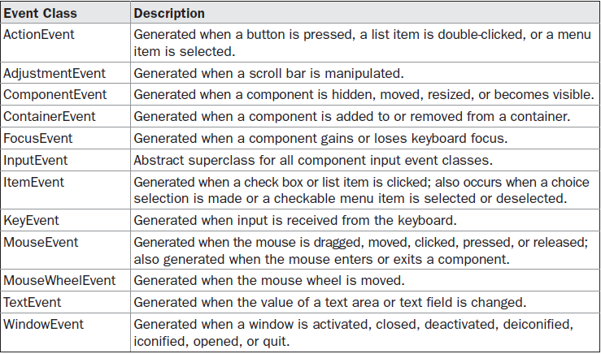
Event Classes in AWT

Slide 13
a) The ActionEvent Class
Generated when:
A button is pressed,
A list item is double-clicked, or
A menu item is selected
5 integer constants used to identify action events:
ALT_MASK, CTRL_MASK, META_MASK, SHIFT_MASK and ACTION_PERFORMED

Slide 14
3 Constructors:
ActionEvent(Object src, int type, String cmd)
ActionEvent(Object src, int type, String cmd, int modifiers)
ActionEvent(Object src, int type, String cmd, long when, int modifiers)
Src → source; type→type of event; cmd → command; modifiers → which modifiers are pressed ALT, CTRL, META and or SHIFT; when → when the event occurred
Command name, modifiers and time values are obtained by:
String getActionCommand( )
int getModifiers( )
long getWhen( )

Slide 15
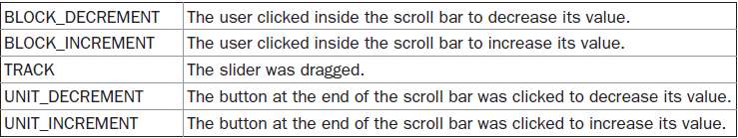
b) The AdjustmentEvent Class
Generated by a scroll bar; 5 types of adjustment events
An integer constant: ADJUSTMENT_VALUE_CHANGED
Constructor:
AdjustmentEvent(Adjustable src, int id, int type, int data)
Getting the source object, type and id:
Adjustable getAdjustable( ); int getAdjustmentType( ); int getValue( )

Slide 16
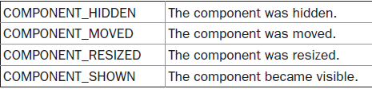
c) The ComponentEvent Class
Generated when the size, position, or visibility of a component is changed.
4 types of component events
Constructor: ComponentEvent(Component src, int type)
Source object is obtained by:
Component getComponent( )

Slide 17
ComponentEvent is the superclass of
ContainerEvent,
FocusEvent,
KeyEvent,
MouseEvent,
WindowEvent.

Slide 18
d) The ContainerEvent Class
Generated when a component is added to or removed from a container
Two types of container events – hence 2 integers:
COMPONENT_ADDED and COMPONENT_REMOVED
Constructor:
ContainerEvent(Component src, int type, Component comp)
Src → main container;
comp →component that is added/removed
Getting Container and Component:
Container getContainer( ); Component getChild( )

Slide 19
e) The FocusEvent Class
Generated when a component gains or loses input focus.
Integer constants: FOCUS_GAINED and FOCUS_LOST
3 constructors:
FocusEvent(Component src, int type)
FocusEvent(Component src, int type, boolean temporaryFlag)
FocusEvent(Component src, int type, boolean temporaryFlag, Component other)
temporaryFlag → is set to true if the focus event is temporary
Other → other component involved in the focus change
Getting other component and temporary flag
Component getOppositeComponent( ); boolean isTemporary( )

Slide 20


f) The InputEvent Class
It’s a abstract class; subclass of ComponentEvent and is the superclass for component input events such as:
KeyEvent and MouseEvent
InputEvent defines the following integer constants:
To resolve the conflict between keyboard and mouse events, the following constants are also supported:

Slide 21
Methods used to test if a modifier was pressed at the time an event is generated:
boolean isAltDown( )
boolean isAltGraphDown( )
boolean isControlDown( )
boolean isMetaDown( )
boolean isShiftDown( )
int getModifiers( ) – Used to obtain a value that contains all of the original modifier flags
int getModifiersEx( ) – Used to obtain the extended modifiers

Slide 22
g) The ItemEvent Class
Generated when
a check box or a list item is clicked or
a checkable menu item is selected or deselected
Three integer constants: SELECTED, DESELECTED and ITEM_STATE_CHANGED
Constructor:
ItemEvent(ItemSelectable src, int type, Object entry, int state)
Src→ source (list or choice element); entry→ the specific item that generated the item event; state → current state of item

Slide 23
The above entries are obtained using:
Object getItem( )
ItemSelectable getItemSelectable( )
int getStateChange( )

Slide 24

h) The KeyEvent Class
Generated when keyboard input occurs
3 types of events and integer constants: KEY_PRESSED, KEY_RELEASED, and KEY_TYPED
KEY_TYPED - occurs only when a character is generated (not for shift, ctrl, alt buttons)
Other integer constants: VK_0 – VK_9 and VK_A – VK_Z
VK – Virtual Key codes (ASCII equivalents)

Slide 25
Constructor:
KeyEvent(Component src, int type, long when, int modifiers, int code, char ch)
Code → VK codes/ VK_UNDEFINED (for shift/alt keys)
Char → character pressed/CHAR_UNDEFINED
The above parameters are obtained using:
char getKeyChar( ); int getKeyCode( )

Slide 26
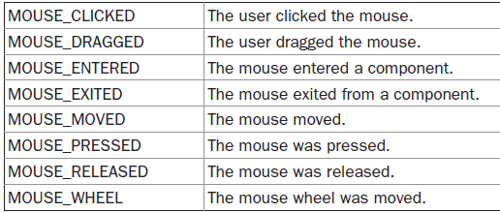
i) The MouseEvent Class
Eight types of mouse events
Constructor:
MouseEvent(Component src, int type, long when, int modifiers, int x, int y, int clicks, boolean triggersPopup)

Slide 27
x and y → The coordinates of the mouse; Clicks → The click count
triggersPopup flag → indicates if this event causes a pop-up menu to appear
Other methods:
int getX( ) and int getY( ) or Point getPoint( ) → position reg the component
void translatePoint(int x, int y) → changes the location of the event
int getClickCount( ); boolean isPopupTrigger( )
int getButton( ) → returns a value that represents the button that caused the event
Some other methods in Java 1.6:
Point getLocationOnScreen( ); int getXOnScreen( ); int getYOnScreen( )

Slide 28

j) The MouseWheelEvent Class
It is a subclass of MouseEvent
Used for scrolling.
MouseWheelEvent defines these two integer constants:
Constructor: MouseWheelEvent(Component src, int type, long when, int modifiers, int x, int y, int clicks, boolean triggersPopup, int scrollHow, int amount, int count)
scrollHow → type of scroll (Block or Unit); Amount → number of units to scroll; count → number of rotational units that the wheel moved

Slide 29
Other methods:
int getWheelRotation( )
int getScrollType( )
int getScrollAmount( )

Slide 30
k) The TextEvent Class
Generated by text fields and text areas when characters are entered by a user or program
Integer constant: TEXT_VALUE_CHANGED
Constructor: TextEvent(Object src, int type)

Slide 31
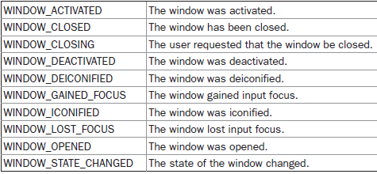
l) The WindowEvent Class
10 types of window events:

Slide 32
Constructors
WindowEvent(Window src, int type)
WindowEvent(Window src, int type, Window other)
WindowEvent(Window src, int type, int fromState, int toState)
WindowEvent(Window src, int type, Window other, int fromState, int toState)
other → the opposite window when a focus or activation event occurs
fromState → the prior state of the window, toState → the new state
Other methods:
Window getWindow( ); Window getOppositeWindow( );
int getOldState( ); int getNewState( )

Slide 33
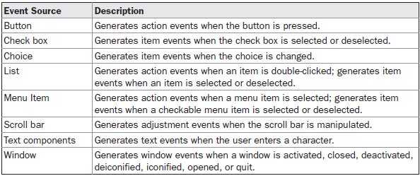
3) Sources of Events

Slide 34
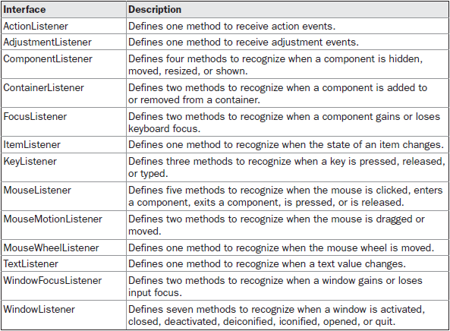
4) Event Listener Interfaces

Slide 35
a) The ActionListener Interface:
void actionPerformed(ActionEvent ae)
b) The AdjustmentListener Interface
void adjustmentValueChanged(AdjustmentEvent ae)
c) The ComponentListener Interface
void componentResized(ComponentEvent ce)
void componentMoved(ComponentEvent ce)
void componentShown(ComponentEvent ce)
void componentHidden(ComponentEvent ce)

Slide 36
d) The ContainerListener Interface
void componentAdded(ContainerEvent ce)
void componentRemoved(ContainerEvent ce)
e) The FocusListener Interface
void focusGained(FocusEvent fe)
void focusLost(FocusEvent fe)
f) The ItemListener Interface
void itemStateChanged(ItemEvent ie)
g) The KeyListener Interface
void keyPressed(KeyEvent ke)
void keyReleased(KeyEvent ke)
void keyTyped(KeyEvent ke)

Slide 37
h) The MouseListener Interface
void mouseClicked(MouseEvent me)
void mouseEntered(MouseEvent me)
void mouseExited(MouseEvent me)
void mousePressed(MouseEvent me)
void mouseReleased(MouseEvent me)
i) The MouseMotionListener Interface
void mouseDragged(MouseEvent me)
void mouseMoved(MouseEvent me)
j) The MouseWheelListener Interface
void mouseWheelMoved(MouseWheelEvent mwe)

Slide 38
k) The TextListener Interface
void textChanged(TextEvent te)
l) The WindowFocusListener Interface
void windowGainedFocus(WindowEvent we)
void windowLostFocus(WindowEvent we)
m) The WindowListener Interface
void windowActivated(WindowEvent we)
void windowClosed(WindowEvent we)
void windowClosing(WindowEvent we)
void windowDeactivated(WindowEvent we)
void windowDeiconified(WindowEvent we)
void windowIconified(WindowEvent we)
void windowOpened(WindowEvent we)

Slide 39
5) Using Delegation Event Model
2 step process:
Implement the appropriate interface in the listener
Implement code to register and unregister (if necessary) the listener – as a recipient for the event notifications
If source code generates multiple event types - Each event must be registered separately
Also one listener may be executed for multiple events

Slide 40
a) Handle Mouse Events
Implement the MouseListener and the MouseMotionListener interfaces.
The program does the following:
Displays the current coordinates of the mouse in the applet’s status window.
Displays “Down” each time the mouse is pressed.
Displays “Up” each time the mouse is released.
Displays “MouseClicked” each time the mouse button is clicked.
Refer SampleMouse.java

Slide 41
b) Handling Keyboard Events
Events Generated:
KEY_PRESSED
KEY_RELEASED
KEY_TYPED
Handlers (listeners) invoked:
keyPressed()
keyReleased()
keyTyped()
Refer SampleKey.java

Slide 42
c)Handling Special Keys
Handling special keys - arrow or function keys
These char codes are not displayed using keyTyped() functions!!!
Use Virtual Key codes
Refer SpecialKey.java

Slide 43
6) Adapter Class
Adapter class is a special feature that simplify the creation of event handlers in certain situations
It provides an empty implementation of all methods in an event listener interface
Adapter classes are useful when you want to receive and process only some of the events that are handled by a particular event listener interface

Slide 44
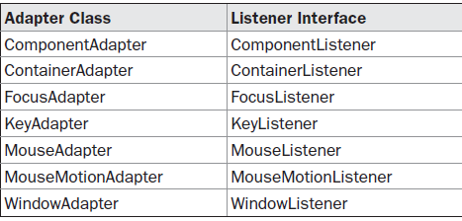
Commonly Used Listener Interfaces Implemented by Adapter Classes

Slide 45
Self Study Topic
Study about Adapter class and Inner classes.
Analyse a program that:
Uses adapter class with the one that doesn't
Uses inner class with the one that doesn't
Submit as assignment on 20th October 2015.

